Slide 1
Position, Displacement, Velocity, and Acceleration
Dr. Jacob Moore
Associate Professor of Engineering
Penn State Mont Alto

Slide 2
Position, Displacement, Velocity and Acceleration
In engineering mechanics, the concepts of position, displacement, velocity, and acceleration are used to describe the motion of a body.
You may have heard of these concepts before, but it’s important to know exactly what we mean by each concept, as they have very specific definitions within engineering.

Slide 3


Position
The concept of position, is simply the location of a body.
For a particle, this refers to the location of the body itself.
For an extended body (often just called a rigid body) it will usually refer to the location of the center of mass of the body.

Slide 4

Position
Generally, there are two ways to describe the position of a body, we can use a distance and direction from a known point, or we can describe a location in terms of distances along set coordinate axes.
In either case it is important that we clearly identify the origin location and the axes we are using.
y
y
x
r
y
$$θ$$
x
x

Slide 5



Position in 3D
In three dimensions, we still have either a distance and direction or the coordinate axes options, but we will need two angles for a direction, or we will need distances in three coordinate directions.
y
$$r$$
$$ϕ$$
y
x
x
$$θ$$
z
z

Slide 6


Displacement
The displacement of a body is simply the change in position of a body between two points in time.
This will be a vector quantity having magnitude and direction.
y
$$t_{1}$$
x₁
Displacement
x₂
$$t_{2}$$
y₁
y₂
x

Slide 7




Displacement
Another important aspect of displacement is the issue of path independence, meaning that the displacement is always the direct route from location one to location two, regardless of the path taken
$$t_{1}$$
$$t_{1}$$
$$t_{2}$$
$$t_{2}$$

Slide 8
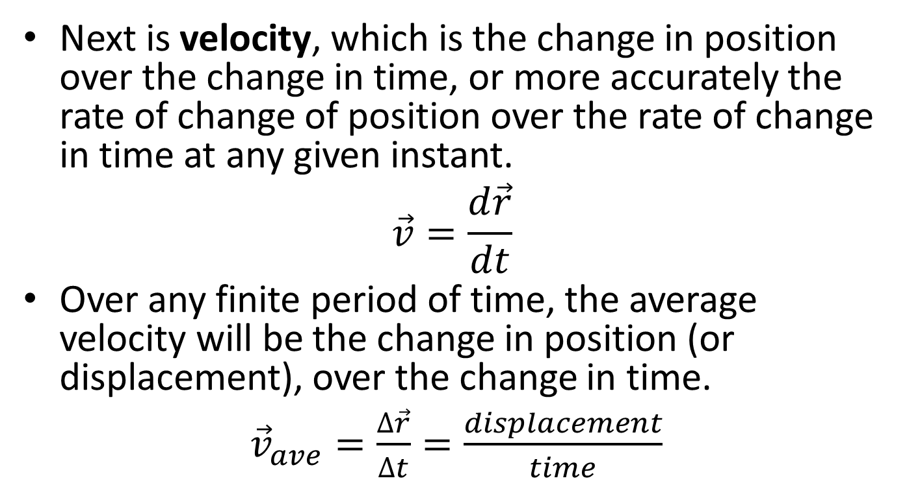
Velocity
Next is velocity, which is the change in position over the change in time, or more accurately the rate of change of position over the rate of change in time at any given instant.
$$\vec{v}=\frac{d\vec{r}}{dt}$$
Over any finite period of time, the average velocity will be the change in position (or displacement), over the change in time.
${\vec{v}}_{ave}=\frac{∆\vec{r}}{∆t}=\frac{displacement}{time}$

Slide 9

Velocity
It’s important to note, that just like displacement, velocity is a vector quantity, having both a magnitude and a direction.
If we just specify the magnitude of the velocity vector, that is the speed of the body.
$$\vec{v}$$

Slide 10
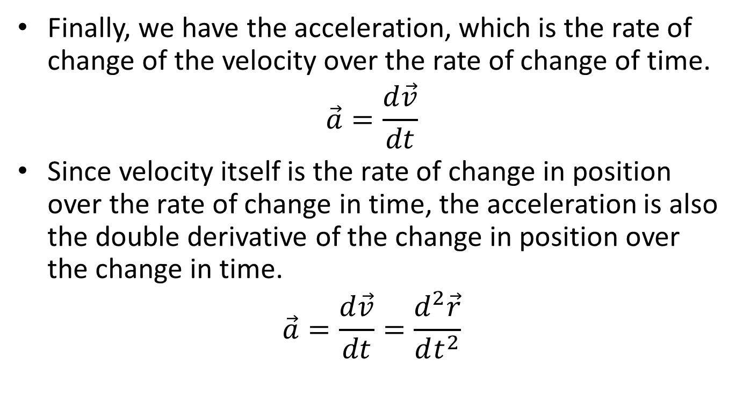
Acceleration
Finally, we have the acceleration, which is the rate of change of the velocity over the rate of change of time.
$$\vec{a}=\frac{d\vec{v}}{dt}$$
Since velocity itself is the rate of change in position over the rate of change in time, the acceleration is also the double derivative of the change in position over the change in time.
$$\vec{a}=\frac{d\vec{v}}{dt}=\frac{d^{2}\vec{r}}{dt^{2}}$$

Slide 11

Acceleration
Just as with displacement and with velocity, acceleration is a vector quantity, meaning that is has a magnitude and direction.
With accelerations being a change in velocities over time, accelerations occur whenever the speed changes or whenever the direction the velocity changes.
$$\vec{a}$$

Slide 12
Thanks for Watching
See other engineering mechanics videos and access the full tool at…

